Slide 1
FEMA Assistant Using Retrieval-Augmented Generation (RAG)
By – Ivan lobo
Class – ISEM 770 Advanced Topics in ISEM

Slide 2
Motivation and Problem Statement
FEMA has vast libraries of emergency management documents—often PDFs—full of valuable information.
Traditional search and manual review are slow and error-prone during urgent situations.
Goal: Enable rapid, smart question answering over large FEMA documents, improving preparedness and response.
Approach:
Use Retrieval-Augmented Generation (RAG)
Incorporate both OpenAI and Gemini APIs
Enable context-aware, document-grounded question answering
Input: FEMA-related PDF documents (6)
Output: Best answer retrieved and generated from documents

Slide 3
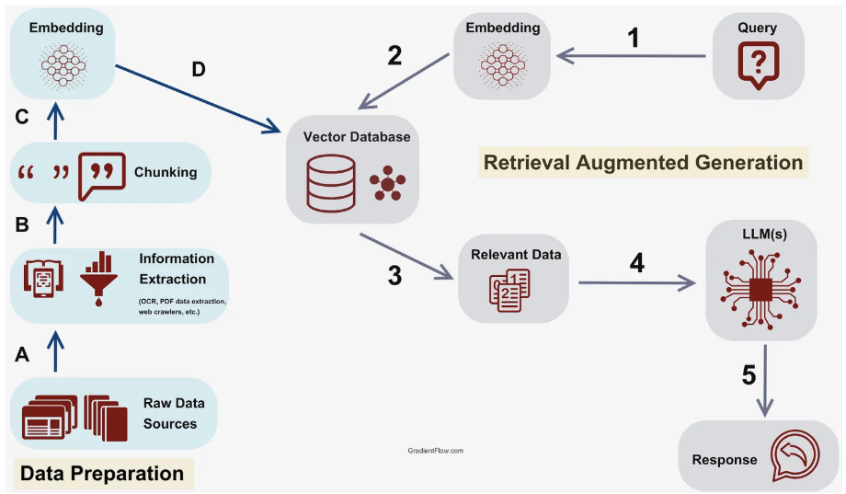
Retrieval-Augmented Generation
RAG is an AI approach that combines search and generation: it first retrieves relevant pieces of information (snippets, facts, passages) from a trove of documents, and then feeds them to a powerful language model (like ChatGPT or Gemini) which creates a well-formed answer using only the retrieved material.
It keeps answers grounded in real data (not hallucinated), and scales to answer questions over huge document sets.
I implemented three RAG variations to improve performance in different FEMA scenarios
Sourced From Gradient Flow

Slide 4
RAG Techniques Overview
Standard RAG.
How it works:
Split documents into overlapping chunks
Embed each chunk using OpenAI or Gemini
Store embeddings in a vector database
At query time, embed the question and retrieve top-k similar chunks
Send those chunks to the LLM to generate an answer
When it's useful:
Direct Q&A ("What is FEMA’s disaster recovery plan?")
Fast and computationally light

Slide 5
RAG Techniques Overview - Contd
Hierarchical RAG
How it works:
Step 1: Summarize each page using the LLM (build high-level overview)
Step 2: Embed those summaries
Step 3: Retrieve relevant summaries for the question
Step 4: Drill down into full-text chunks from those summaries
Step 5: Generate answer using LLM from detailed context
Why this helps:
Improves answer accuracy by reducing irrelevant context
More aligned with how humans read: skim first, then read in-depth
Use cases:
Long policy documents
Complex questions requiring cross-reference
Graph-based RAG
How it works:
Extract key concepts from each chunk
Build a knowledge graph: nodes = chunks, edges = semantic or keyword similarity
Traverse graph starting from the query node, retrieving semantically connected chunks
Answer is generated from traversed context
Why this helps:
Captures relationships across documents
Useful for multi-hop reasoning or indirect answers
Example:
"Which agencies coordinate with FEMA during hurricanes?" may require finding relationships beyond a single paragraph

Slide 6
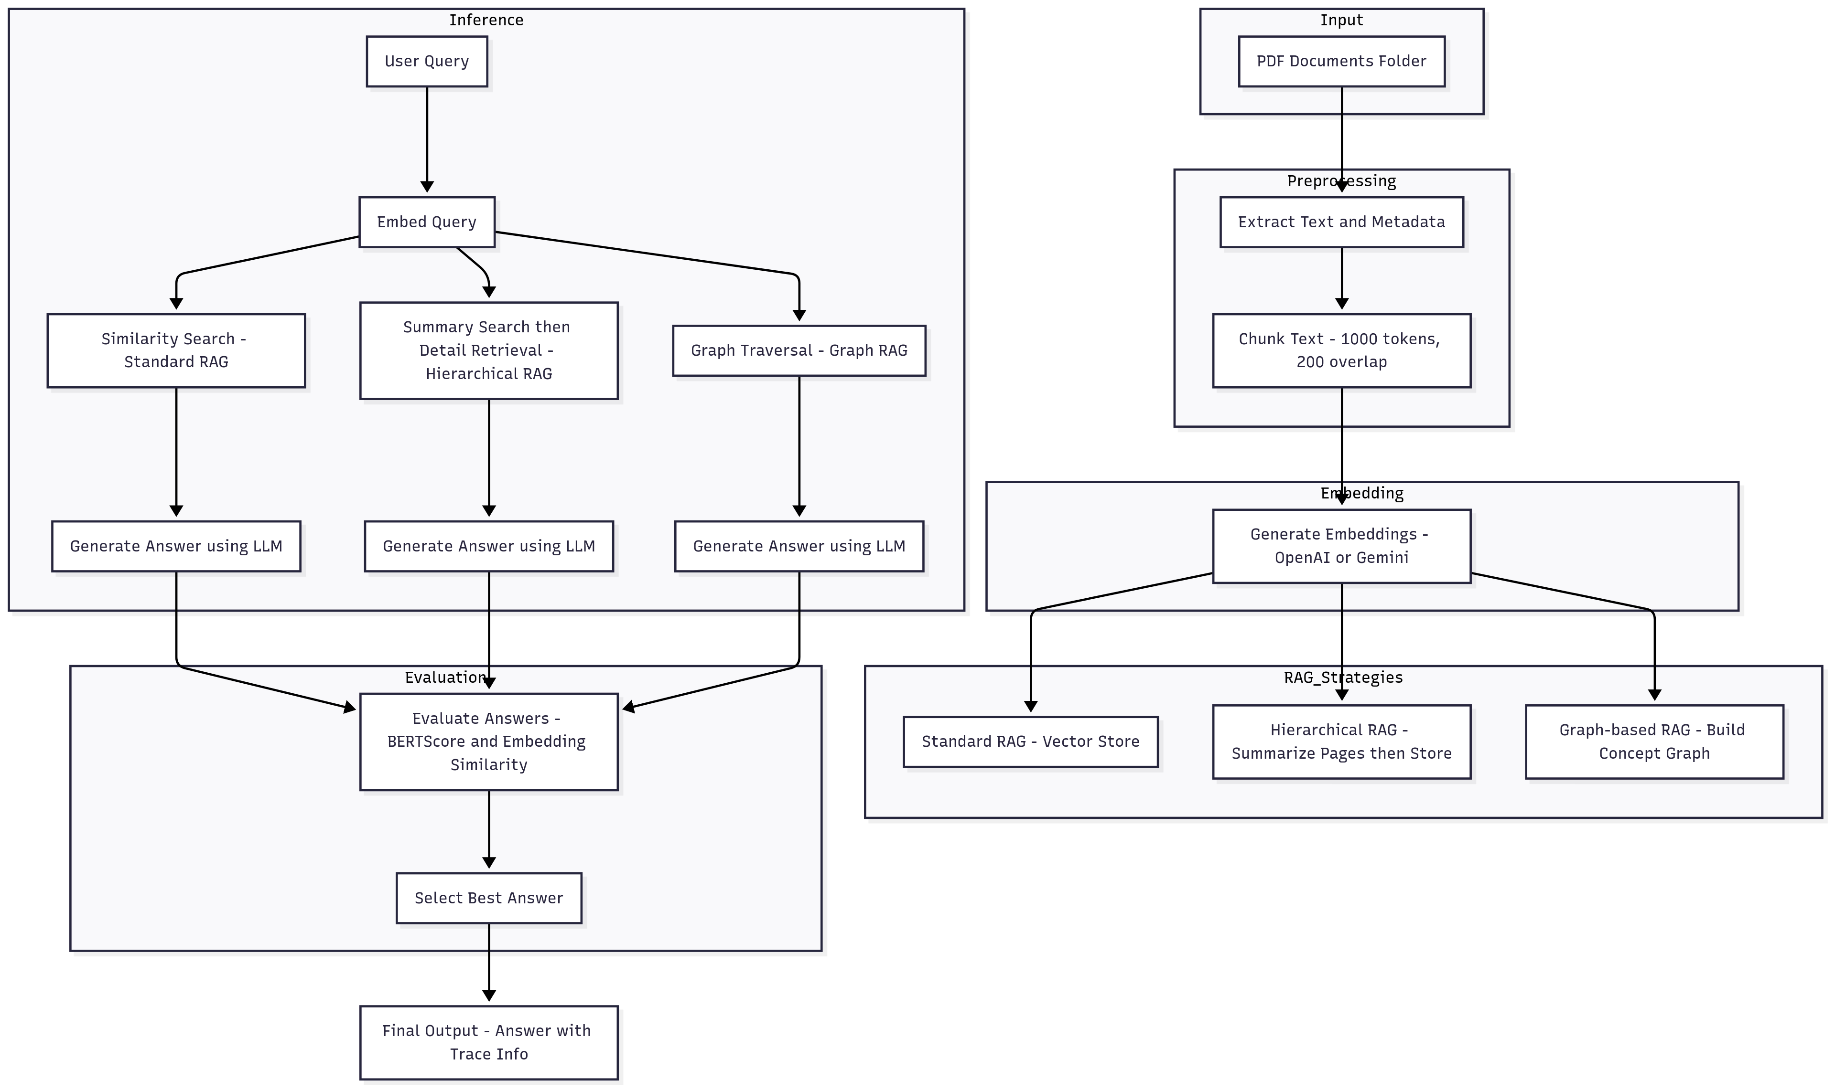
FEMA Assistant Process Flow
Notes:
RAG Pipeline Code Blocks Process Flow
🏁 Entry Point
compare_all_rag_fast() - Main orchestrator function that runs all three RAG strategies
📁 Document Processing Layer
Core Utilities
extract_text_from_pdf() - Extracts text from individual PDF files using PyMuPDF
extract_texts_from_folder() - Processes all PDFs in a folder
chunk_text() - Splits text into overlapping chunks (default: 1000 chars, 200 overlap)
Caching System
get_cache_key() - Generates MD5 hash for cache keys
load_cache() / save_cache() - Persistent disk caching for embeddings
🔗 Embedding & Vector Operations
Embedding Creation
create_embeddings_cached() - OPTIMIZED Gemini embedding with caching
Checks cache first before API calls
Batch processing (100 texts per call)
Handles single query vs batch scenarios
create_embeddings() - Original version (backward compatibility)
Vector Store
SimpleVectorStore class:
add_item() - Stores text, embedding, metadata
similarity_search() - Cosine similarity search with optional filtering
🤖 LLM Integration
Response Generation
generate_response() - Gemini 2.0 Flash for RAG responses
Uses context chunks and system prompt
Temperature: 0.2 for consistency
Concept Extraction
extract_concepts_simple() - FAST regex-based concept extraction
extract_concepts() - Original LLM-based extraction (slower)
🎯 RAG Strategy 1: Standard RAG
Main Function
standard_rag_cached() - OPTIMIZED with full caching
Check for existing cache file
If no cache: extract → chunk → embed → store
Query: embed query → similarity search → generate response
Legacy
standard_rag() - Original version without caching
🏗️ RAG Strategy 2: Hierarchical RAG
Main Function
hierarchical_rag() - Two-tier retrieval system
Summary Level: Page summaries for broad relevance
Detail Level: Chunk-level retrieval within relevant pages
Supporting Functions
generate_page_summary() - Gemini-powered page summarization
Uses two separate vector stores (summaries + detailed chunks)
Filtering mechanism to focus detailed search on relevant sources
🕸️ RAG Strategy 3: Graph RAG
Main Functions
graph_rag_fast() - OPTIMIZED version without LLM concept extraction
graph_rag() - Original version with LLM concepts
Graph Construction
build_knowledge_graph_fast() - OPTIMIZED approach:
Simple regex-based concept extraction
Vectorized similarity matrix computation
NetworkX graph with similarity-based edges
build_knowledge_graph() - Original with LLM concept extraction
Graph Traversal
traverse_graph() - Multi-hop traversal:
Find most similar starting nodes
Use Dijkstra-like traversal following edge weights
Return connected relevant chunks
✅ Validation & Evaluation
Validation Functions
get_reference_answer() - Loads ground truth from val.json
validate_answers() - Compares all three strategies:
gemini_similarity_score() - Embedding-based similarity
bert_f1_score() - BERTScore F1 evaluation
update_results_csv() - Updates evaluation spreadsheet
📊 Analysis & Visualization
Plotting Functions
plot_graph_rag() - Visualizes knowledge graph structure
plot_bertscore_heatmap() - Comparative BERTScore analysis

Slide 7
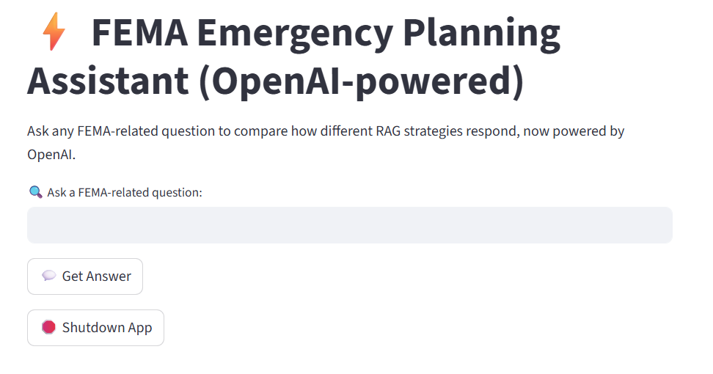
Demo

Slide 8
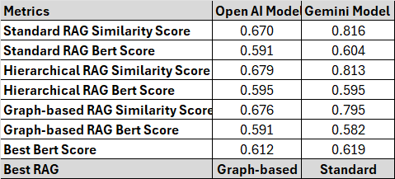
Evaluations – Phase 1
Gemini outperforms OpenAI on all Similarity metrics (0.81–0.82 vs 0.67–0.68), showing significantly stronger context-aware answer matching.
BERT Scores are very close across models, but Gemini achieves a marginal lead for the top-scoring RAG.
Best RAG differs by model:
OpenAI's strongest RAG is Graph-based (BERT: 0.612)
Gemini's is Standard RAG (BERT: 0.619)
Consistent Trend: Gemini boosts the effectiveness of retrieval and answer quality, making Standard and Hierarchical approaches particularly strong.

Slide 9
Evaluations – Phase 2 - Performance Analysis
Key Strengths (What it does well)
Direct Information Retrieval: Excels at extracting and presenting information directly available in source texts, leading to high semantic alignment.
Semantic Comprehension: Demonstrates strong understanding of query intent, accurately matching meaning even with varied phrasing.
Comprehensive Detail (when accurate): Capable of providing thorough and relevant details for well-covered topics, enriching responses.
Areas for Improvement (Future Enhancements)
"No Information" Handling: Needs refinement in responding to unanswerable queries; current verbose summaries reduce clarity and user experience.
Accuracy & Precision: Requires improved factual accuracy to avoid contradictions and ensure alignment with ideal answers.
Conciseness & Relevance: Opportunities to filter extraneous details, ensuring responses are focused and directly address the core of the query.

Slide 10
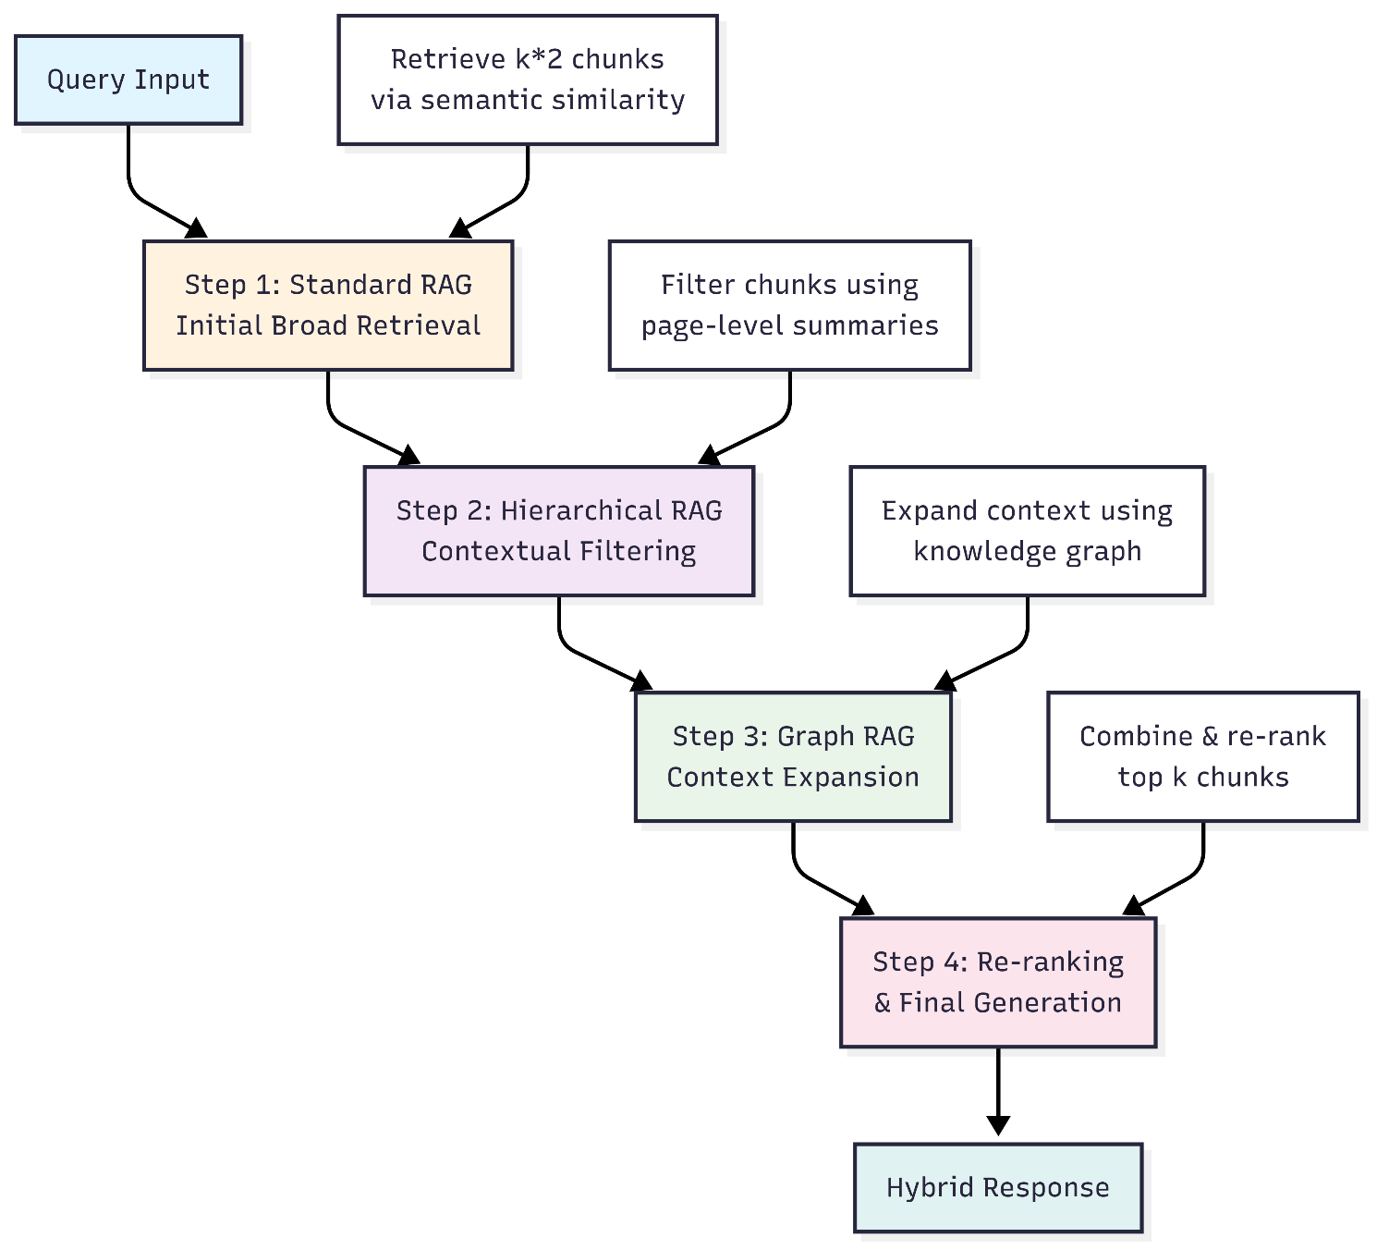
Combination Of techniques

Slide 11
Conclusion
RAG-powered FEMA Assistant enables rapid, accurate, and context-aware question-answering over complex emergency documents, supporting preparedness and response.
Standard, Graph-based, and Hierarchical RAG strategies each address unique information retrieval challenges—balancing accuracy, reasoning, and scalability.
Gemini outperforms OpenAI in context comprehension and answer quality, especially with Standard and Hierarchical RAG.
Ongoing improvements will target enhanced intent recognition, precision, and concise answer synthesis for better real-world usability.
The RAG Assistant can provide a foundation for next-generation emergency management tools, bridging the gap between vast FEMA resources and fast, trustworthy answers.

Slide 12
References
Federal Emergency Management Agency. (n.d.). FEMA. https://www.fema.gov/
Lorica, B. (2023, Oct 19). Best practices in retrieval‑augmented. Gradient Flow. https://gradientflow.substack.com/p/best-practices-in-retrieval-augmented
Danter, D., Mühle, H., & Stöckl, A. (2024). Advanced Chunking and Search Methods for Improved Retrieval-Augmented Generation (RAG) System Performance in E-Learning. AHFE International. https://doi.org/10.54941/ahfe1005756.
Wang, S., Fang, Y., Zhou, Y., Liu, X., & , Y. (2025). ArchRAG: Attributed Community-based Hierarchical Retrieval-Augmented Generation. ArXiv, abs/2502.09891. https://doi.org/10.48550/arXiv.2502.09891.
Raschka, S. (2024). Machine Learning Q and AI: 30 Essential Questions and Answers on Machine Learning and AI. No Starch Press.

